Slide 1
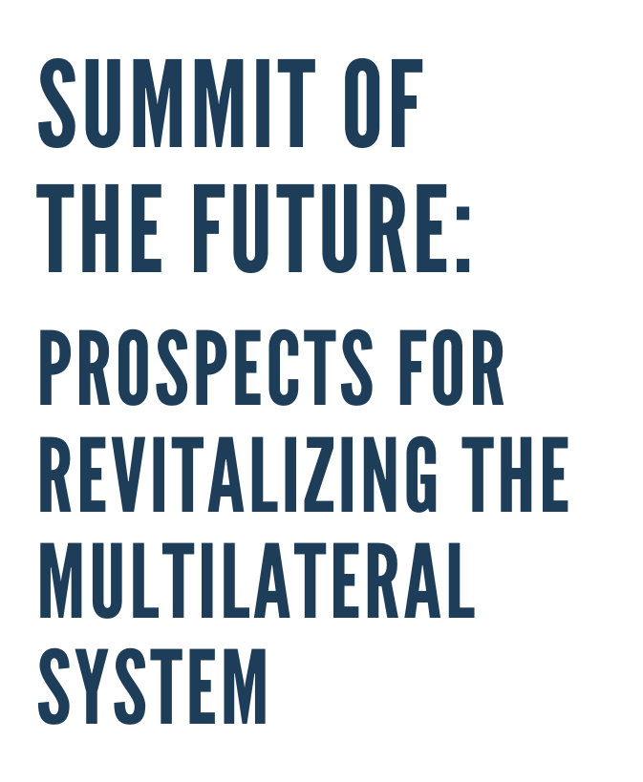

Slide 2
INFORMAL DIALOGUE QUESTIONS
What are the challenges and opportunities faced in ensuring the success of the Summit of the Future as well as the overall reform process, and how can regional organizations, such as ASEAN, contribute to the success of this process?
In what ways can the United Nations and ASEAN jointly leverage their expertise and resources to address current and emerging regional and global issues, such as green and sustainable growth, climate change and disaster risk reduction, digital transition, sustaining peace, cyber security and outer-space, etc., that not only benefits current populations, but also safeguards the well-being of future generations?

Slide 3
BIENNIAL UN-G20+ SUMMIT FOR THE GLOBAL ECONOMY
Challenge:
Addressing the need for greater stability in our globalized economy (e.g., by mitigating and managing cross-border shocks), as well as a reduction in global inequality due, in part, to a lack of representation of vulnerable countries within the G20-centered global economy.
Enhance coordination of G20 members with the UN system, the world body’s 193 Member States, International Financial Institutions (IFIs), World Trade Organization, and UN Secretariat – supported by a small, full-time “networked” secretariat” – by convening a Biennial UN-G20+ Summit during the UN General Assembly’s High-Level Week to foster a more sustainable and balanced global economy.
Look to leadership from ASEAN, the EU, AU, and select G20 members.
Convince reluctant powerful (G20) countries & LDCs too of the benefits of expanded multilateral coordination and risk reduction in global economic governance.
Reform Proposal:
Strategy for Reform:

Slide 4
AN EMPOWERED UN PEACEBUILDING COUNCIL
Challenge:
Gaps in how the UN Security Council provides for civilian protection, sustains peace, and reduces violent conflict outbreaks and recurrence.
Upgrade the UN Peacebuilding Commission into an empowered Peacebuilding Council. This new body would lead on conflict prevention (with a Peacebuilding Audit tool) peacebuilding policy development, coordination, and resource mobilization.
After calling for the Peacebuilding Commission’s transformation in the Summit of the Future, leverage, in 2025, the UN Peacebuilding Architecture Review consultations.
Pilot test the proposed Peacebuilding Audit tool, deriving lessons from the UN Human Rights Council’s Universal Periodic Review (a significant outcome of the 2005 UN60 World Leaders Summit).
Reform Proposal:
Strategy for Reform:

Slide 5
INTERNATIONAL ARTIFICIAL INTELLIGENCE AGENCY (IA2)
Challenge:
While growing at an exponential rate with immense economic and social potential, Artificial Intelligence is also increasingly misused as it becomes ubiquitous, generating serious risks for society, including as a new means of warfare and international terrorism.
Reform Proposal:
The new IA2 would serve to: i) improve visibility, advocacy, and resource mobilization for global AI regulatory efforts; ii) provide thought leadership on AI and cyber-tech initiatives; iii) monitor, evaluate, and report on AI industry safeguards; and iv) enhance coordination and knowledge-sharing across Member States and regional bodies, such as ASEAN, to leverage AI’s positive development applications.
Strategy for Reform:
Build on the S-G’s new High-Level Advisory Body on Artificial Intelligence to establish an Intergovernmental Cyber and AI Panel (model on the Intergovernmental Panel on Climate Change).
Seed the idea of an IA2 in both the Global Digital Compact and Chapter 3 of the Pact for the Future, while elaborating in two (simultaneous) operational GA and SC resolutions before the end of 2024.

Slide 6
EARTH STEWARDSHIP COUNCIL (ESC)
& SPECIAL ENVOY ON FUTURE GENERATIONS
Challenge:
Knowledge and action gaps in international policy-making in support of future generations have suffered from short-termism, high inequality, and unaccountability, as well as the “tragedy of the commons.”
Reform Proposal:
An Earth Stewardship Council (ESC) could serve as an oversight body of the Declaration on Future Generations (including through a “Future Generations Review,” modeled on the HRC’s Universal Periodic Review) and deliberate upon the governance of the global commons. A new Special Envoy for Future Generations could further give voice to future generations within the UN’s highest echelon.
Strategy for Reform:
Seed the idea of an ESC (including a Future Generations Review) and a Special Envoy on Future Generations in both the Declaration on Future Generations and Chapter 4 of the Pact for the Future, while elaborating in two (simultaneous) operational GA and SC resolutions before the end of 2024.

Slide 7
GLOBAL ECONOMIC & FINANCIAL REFORM
& GREATER COLLABORATION WITH REGIONAL ORGANIZATIONS
Challenge:
To advance the 20230 Agenda, the SDG Political Declaration calls for: “... SDG investments, reforming the international financial architecture … enhancing macroeconomic policy coordination” (governance gaps)
Reform Proposal:
Major Global Economic & Financial Reforms, while encouraging greater collaboration with Regional Development Banks and other Regional Organizations, include: i) Repurposing the Multilateral Development Bank system (e.g., expanding lending capacity by USD $100 billion, de-risking measures, and further issuing of SDRs); and ii) Strengthening the Global Debt Architecture (e.g., new debt treatment global coordination platform, aligning China with the Paris Club, and debt for climate swaps).
Strategy for Reform:
Build on the momentum generated by Mia Mottley’s Bridgetown Initiative, among other factors..
Synchronize with the reform efforts of the new World Bank President, Ajay Banga.

Slide 8
STRATEGY FOR REFORM

